Slide 1
Controls System Architecture
Kunal Shroff
Software Technical Lead
EIC Accelerator Controls Global Software, Networking & Computing PDR
June 15-17, 2026

Slide 2
About Me – Kunal Shroff
I am the Controls Software Technical Lead for the Electron-Ion Collider (EIC) at Brookhaven National Laboratory, where I lead the architecture and deployment strategy for controls software and operational services.
I have 17 years of experience developing control systems software for large scientific facilities and serve as the technical lead of the EPICS Phoebus Collaboration, an international effort developing next-generation tools and services for accelerator control systems.
Education
M.S. Electrical & Computer Engineering, Stony Brook University
Technical Focus
Controls Architecture
EPICS & Phoebus
Distributed Systems
DevOps, CI/CD, & Infrastructure Automation

Slide 3
Charge Questions
Are the system requirements sufficiently defined, understood, and documented for this phase of the design?
Do the designs meet the requirements?
Are the interfaces sufficiently defined, understood and documented for this phase of the design?
Are the design analysis, simulations, drawings and specifications, and work plans, sufficient for this phase of the design?
Have technical risks been identified and are mitigation plans adequate for this phase of the design?
Are plans to address ES&H and Quality sufficient for this phase of the design?
Is the overall design maturity sufficient to proceed with the final design phase?

Slide 4
Outline
Scope
Architecture
EPICS
ADO, dual-system coexistence, tradeoffs, and decision matrix
Network architecture, subnet strategy, and buildout plan
EPICS IOC continuity and pvAccess protocol value
Middle-layer services
Phoebus toolkit
CI/CD governance, automation stack, QA/QC gates, and domain pipelines
Path Forward
Summary

Slide 5
Scope
Charge #1-7
Controls system architecture baseline (EPICS 7, PVA-first)
Coexistence strategy for EPICS and legacy ADO systems
Middle-layer services and operator tools
Network and infrastructure architecture
CI/CD and governance model

Slide 6
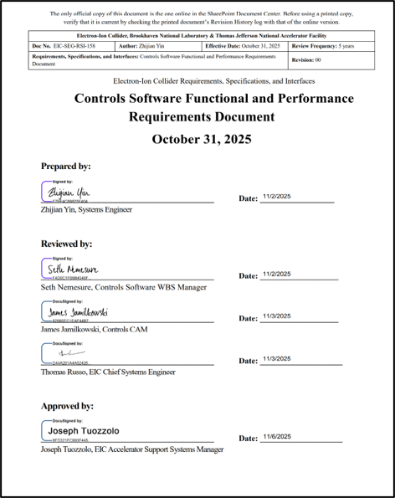
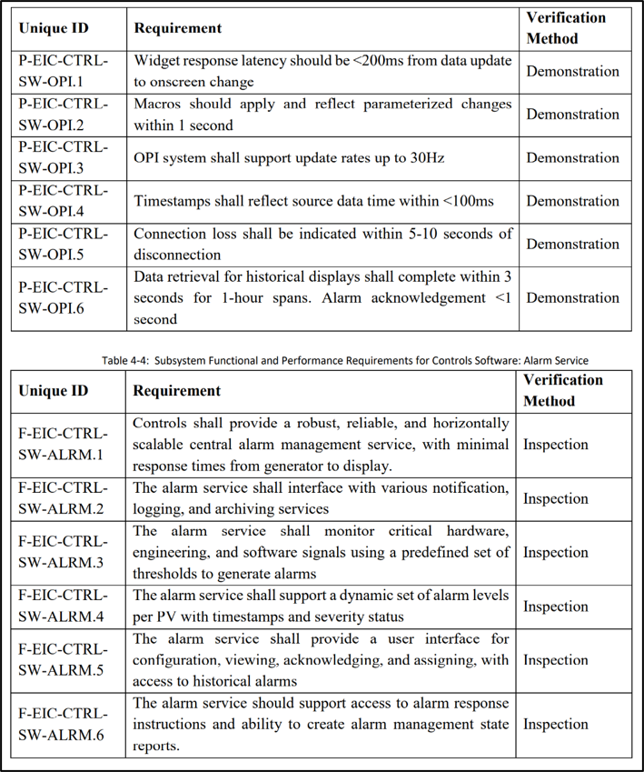
Requirements
Charge #1,3
Initial versions of the Performance Requirements Documents (PRDs)
High Level Applications [EIC-SEG-RSI-158]
Networking & Computing [EIC-SEG-RSI-124]

Slide 7
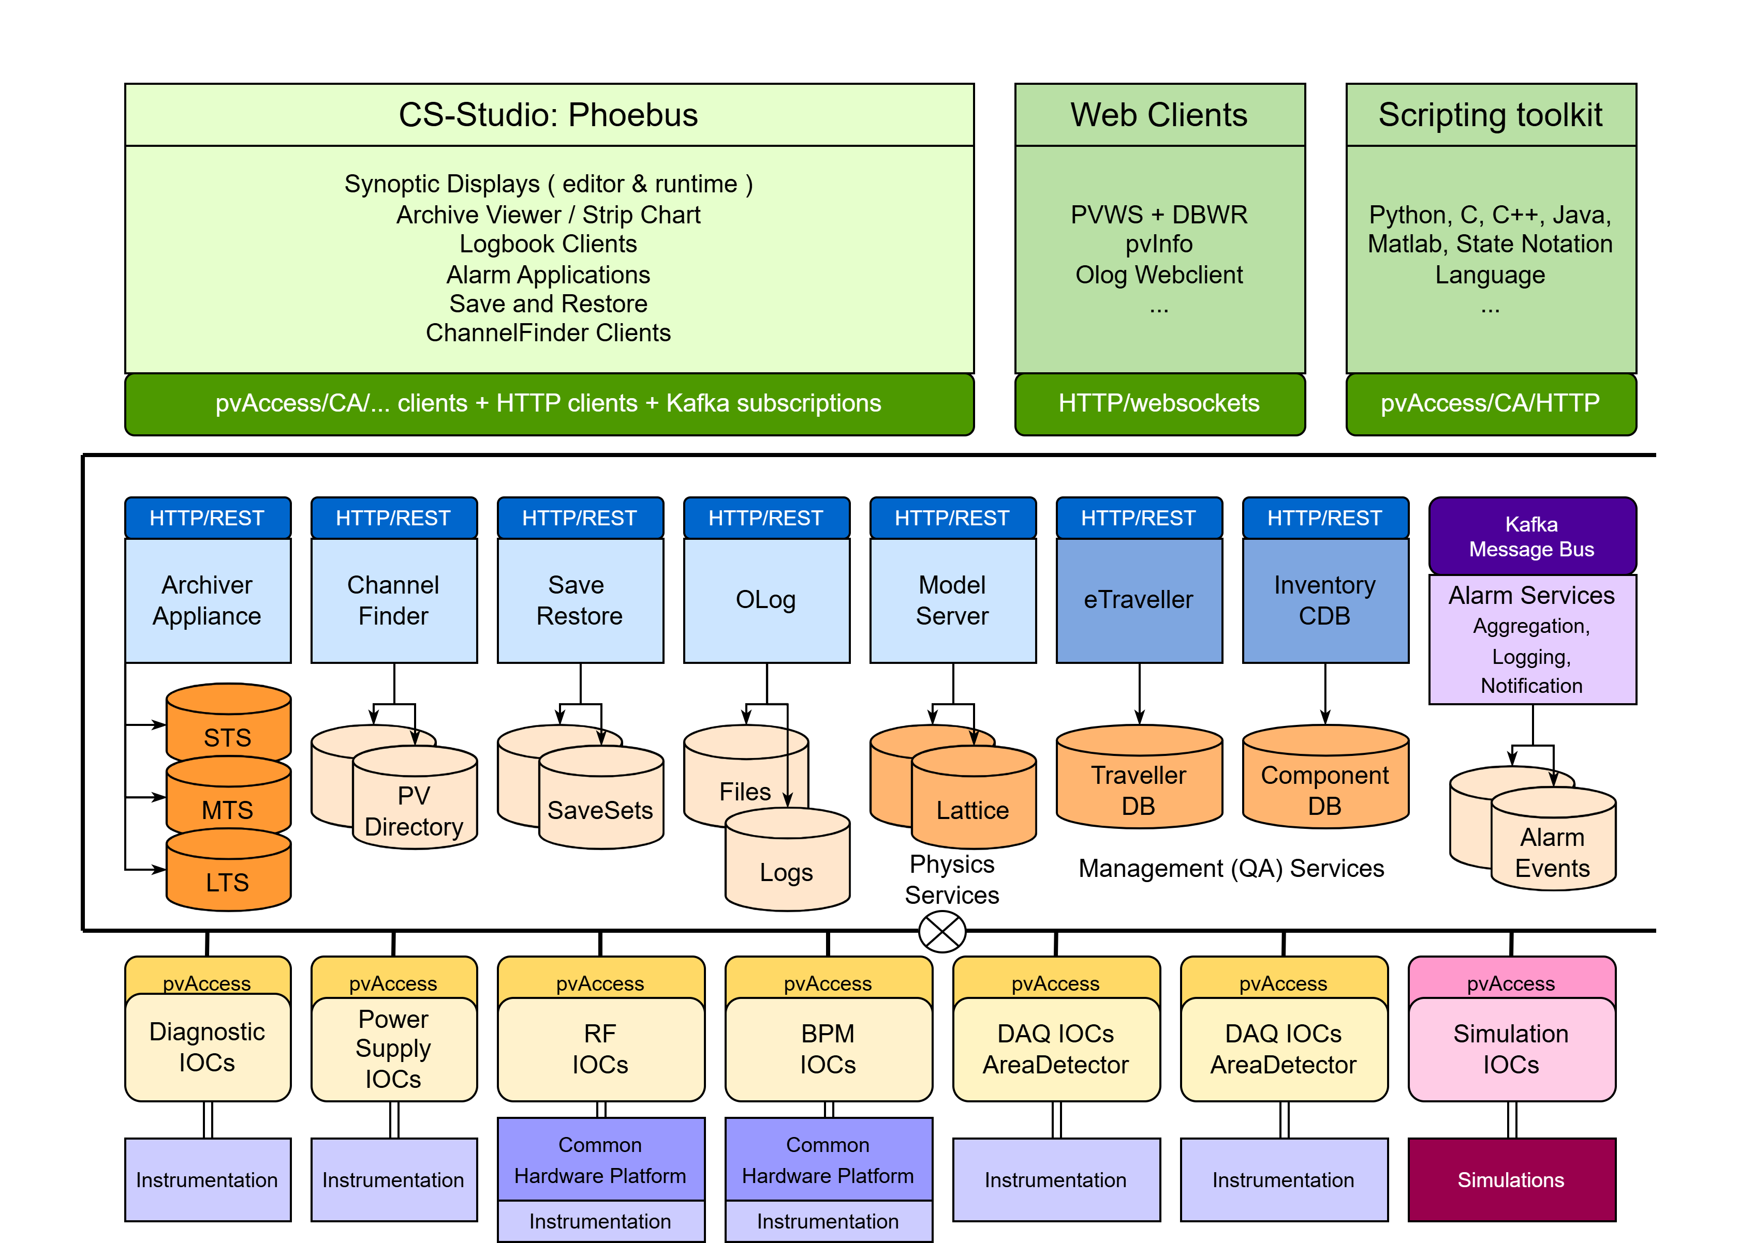
Control System Architecture
Charge #1-5
Operator and application layer (Phoebus tools, web tools, HLAs) [EIC-ROD-069] [Talk-12-Shroff]
Middle-layer services (Archiver, Alarm, Olog, ChannelFinder, Save/Restore, Gateway) [Talk-11-Nemesure]
Control system layer (EPICS 7 with PVA, ADO compatibility) [EIC-ROD-056]

Slide 8
Control System Architecture
Charge #1-5
Operator and application layer (Phoebus tools, web tools, HLAs)
Middle-layer services (Archiver, Alarm, Olog, ChannelFinder, Save/Restore, Gateway)
Control system layer (EPICS 7 with PVA-first, CA compatibility)

Slide 9
EPICS Control System
Charge #1,2
What EPICS is: Open-source control system toolkit used across accelerator and large experimental facilities
Distributed architecture: independent IOCs which embed controls logic and provide an interface to hardware
Core communication model: client/server plus publish-subscribe behavior for scalable monitoring and control
Scalability: modular deployment, incremental expansion
Technology ecosystem: large EPICS ecosystem of community-maintained modules, device support, drivers, and operations tools
Longevity: active multi-lab collaboration over decades

Slide 10
EPICS for EIC
Charge #1-4
Functional support:
Distributed IOC model supports heterogeneous subsystems and interfaces
PVA protocol path supports structured data exchange and service integration for new EIC systems
Normative Types (`NTScalar`, `NTArray`, `NTNDArray`, `NTTable`) plus modern libraries (PVXS C++, core-pva Java, p4p Python) enable generic clients and service-oriented integration
Reliability and operations support:
Distributed IOC and service architecture reduces single-point concentration risk when deployed with redundancy
Delta subscription updates reduce unnecessary network traffic for rich structures, improving operational efficiency under sustained load
Mature operations tooling ecosystem (`areaDetector`, archiver, alarms, save/restore, metadata tooling) supports production workflows and maintainability

Slide 11
EPICS for EIC
Charge #1-4
Performance and scale support:
EPICS IOC record processing supports standard periodic scan up to 10 Hz in default periodic mode
Architecture supports staged growth through horizontal scaling of IOCs, services, and client workloads
International collaboration support:
EPICS maintains a large global ecosystem of modules, device support, drivers, and tools across Base, IOC modules, and extensions
Community maintenance and distributed expertise across major labs reduce single-site dependency risk
Deployment patterns from EPICS 7 facilities (including ESS, NSLS-II, ITER, APS-U, PIP-II) are directly reusable for EIC

Slide 12
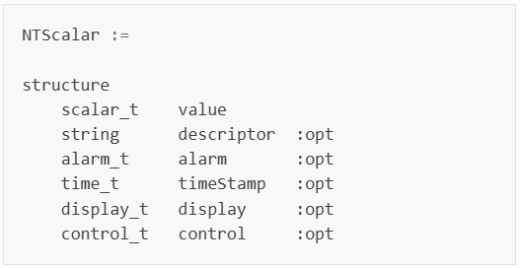
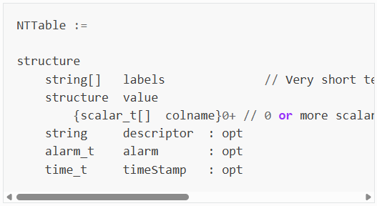
pvAccess Protocol for EIC
Charge #1-4
pvAccess is EPICS's next-generation control protocol.
What pvAccess provides:
Transports structured data types (scalars, arrays, tables, images) with metadata
Efficient subscriptions transfer only changed fields, reducing network load
Supports RPC-style interactions for service-oriented control workflows
Supports high-bandwidth data acquisition, imaging, and large structured payloads such as `NTNDArray`
Supported via multiple client libraries (`PVXS`, `core-pva`, `P4P`), IPv6 support, and planned TLS-secured connections
Notes:
, supporting structured data, efficient subscriptions and notifications, improved security support, and various other features that make it a strong fit for EIC's modern control system needs
- **What pvAccess provides:** - **Extends EPICS with user-defined structured data transport without recompiling client or server code** - **Uses a highly efficient subscription model that sends only changed fields in an updated structure**
As mentioned before, pvAccess handles subscriptions to
structures very efficiently: While a CA subscription for a
DBR_CTRL_DOUBLE data type always transmits the
complete structure with every update, a PVA subscription
will only transmit the parts of the NTScalar structure that
have changed. Fields like the “description” and limits tend
to remain constant and will thus not contribute to the network
traffic during PVA subscription updates
- **Supports request/response style interactions for middle-layer services and control workflows** - **Normative Types and data semantics:** - **Standard types such as `NTScalar`, `NTNDArray`, and `NTTable` preserve value, timestamp, alarm, and display metadata** - **Generic clients can interpret common scalar, array, image, and table structures without custom per-device code** - **Specialized structures remain possible when a use case does not fit a standard type** - **Supports high-bandwidth data acquisition, imaging, and large structured payloads such as `NTNDArray`** - **Enables modern client libraries (`PVXS`, `core-pva`, `P4P`), IPv6 support, and planned TLS-secured connections** - **Has been demonstrated in production at multiple facilities, including ESS commissioning under heavy load**

Slide 13
ADO Control System
Charge #3,4,5
What ADO is: RHIC controls were built in the early 1990s as a network-based distributed, client-server architecture
High-level services cover operator interfaces, sequencing, alarms, archiving, and logbook workflows; low-level control runs through VME/ADO on VxWorks
This architecture has supported RHIC for about 25 years with staged upgrades (including FPGA-based LLRF), demonstrating operational maturity
Current status (still in use):
ADO-based hadron injection controls, including BLIP-related operations, remain active during EIC construction
Existing device integrations and operating experience remain valuable for near-term reliability and commissioning continuity
Notes:
The existing ADO based control system for the hadron injection, which also serves other facilities such as BLIP (Brookhaven Linac Isotope Producer) and still operates during the EIC construction, will remain.
- **RHIC architecture baseline:** - **RHIC controls were built in the early 1990s as a network-based distributed, two-level architecture** - **High-level layer provides operator interfaces, automatic sequencing, alarms, archiving, and logbook workflows** - **Low-level layer controls hardware (magnets, vacuum, others) primarily through VME and ADO applications on VxWorks** - **Operational strengths and track record:** - **The ADO-based system has supported RHIC operations for about 25 years with staged upgrades (including FPGA-based LLRF improvements)** - **Established device integrations and operating practices remain a critical asset for injector-era systems** - **Why ADO remains in use now:** - **The existing ADO control path for hadron injection and BLIP remains operational during EIC construction** - **Program execution requires coexistence while new EPICS/PVA systems are commissioned** - **Transition driver for EIC:** - **EIC performance goals (about two orders of magnitude luminosity increase vs RHIC) require state-of-the-art controls evolution** - **EIC lower-level controls are moving to a modular, scalable FPGA platform for timing, LLRF, instrumentation, and related subsystems**

Slide 14
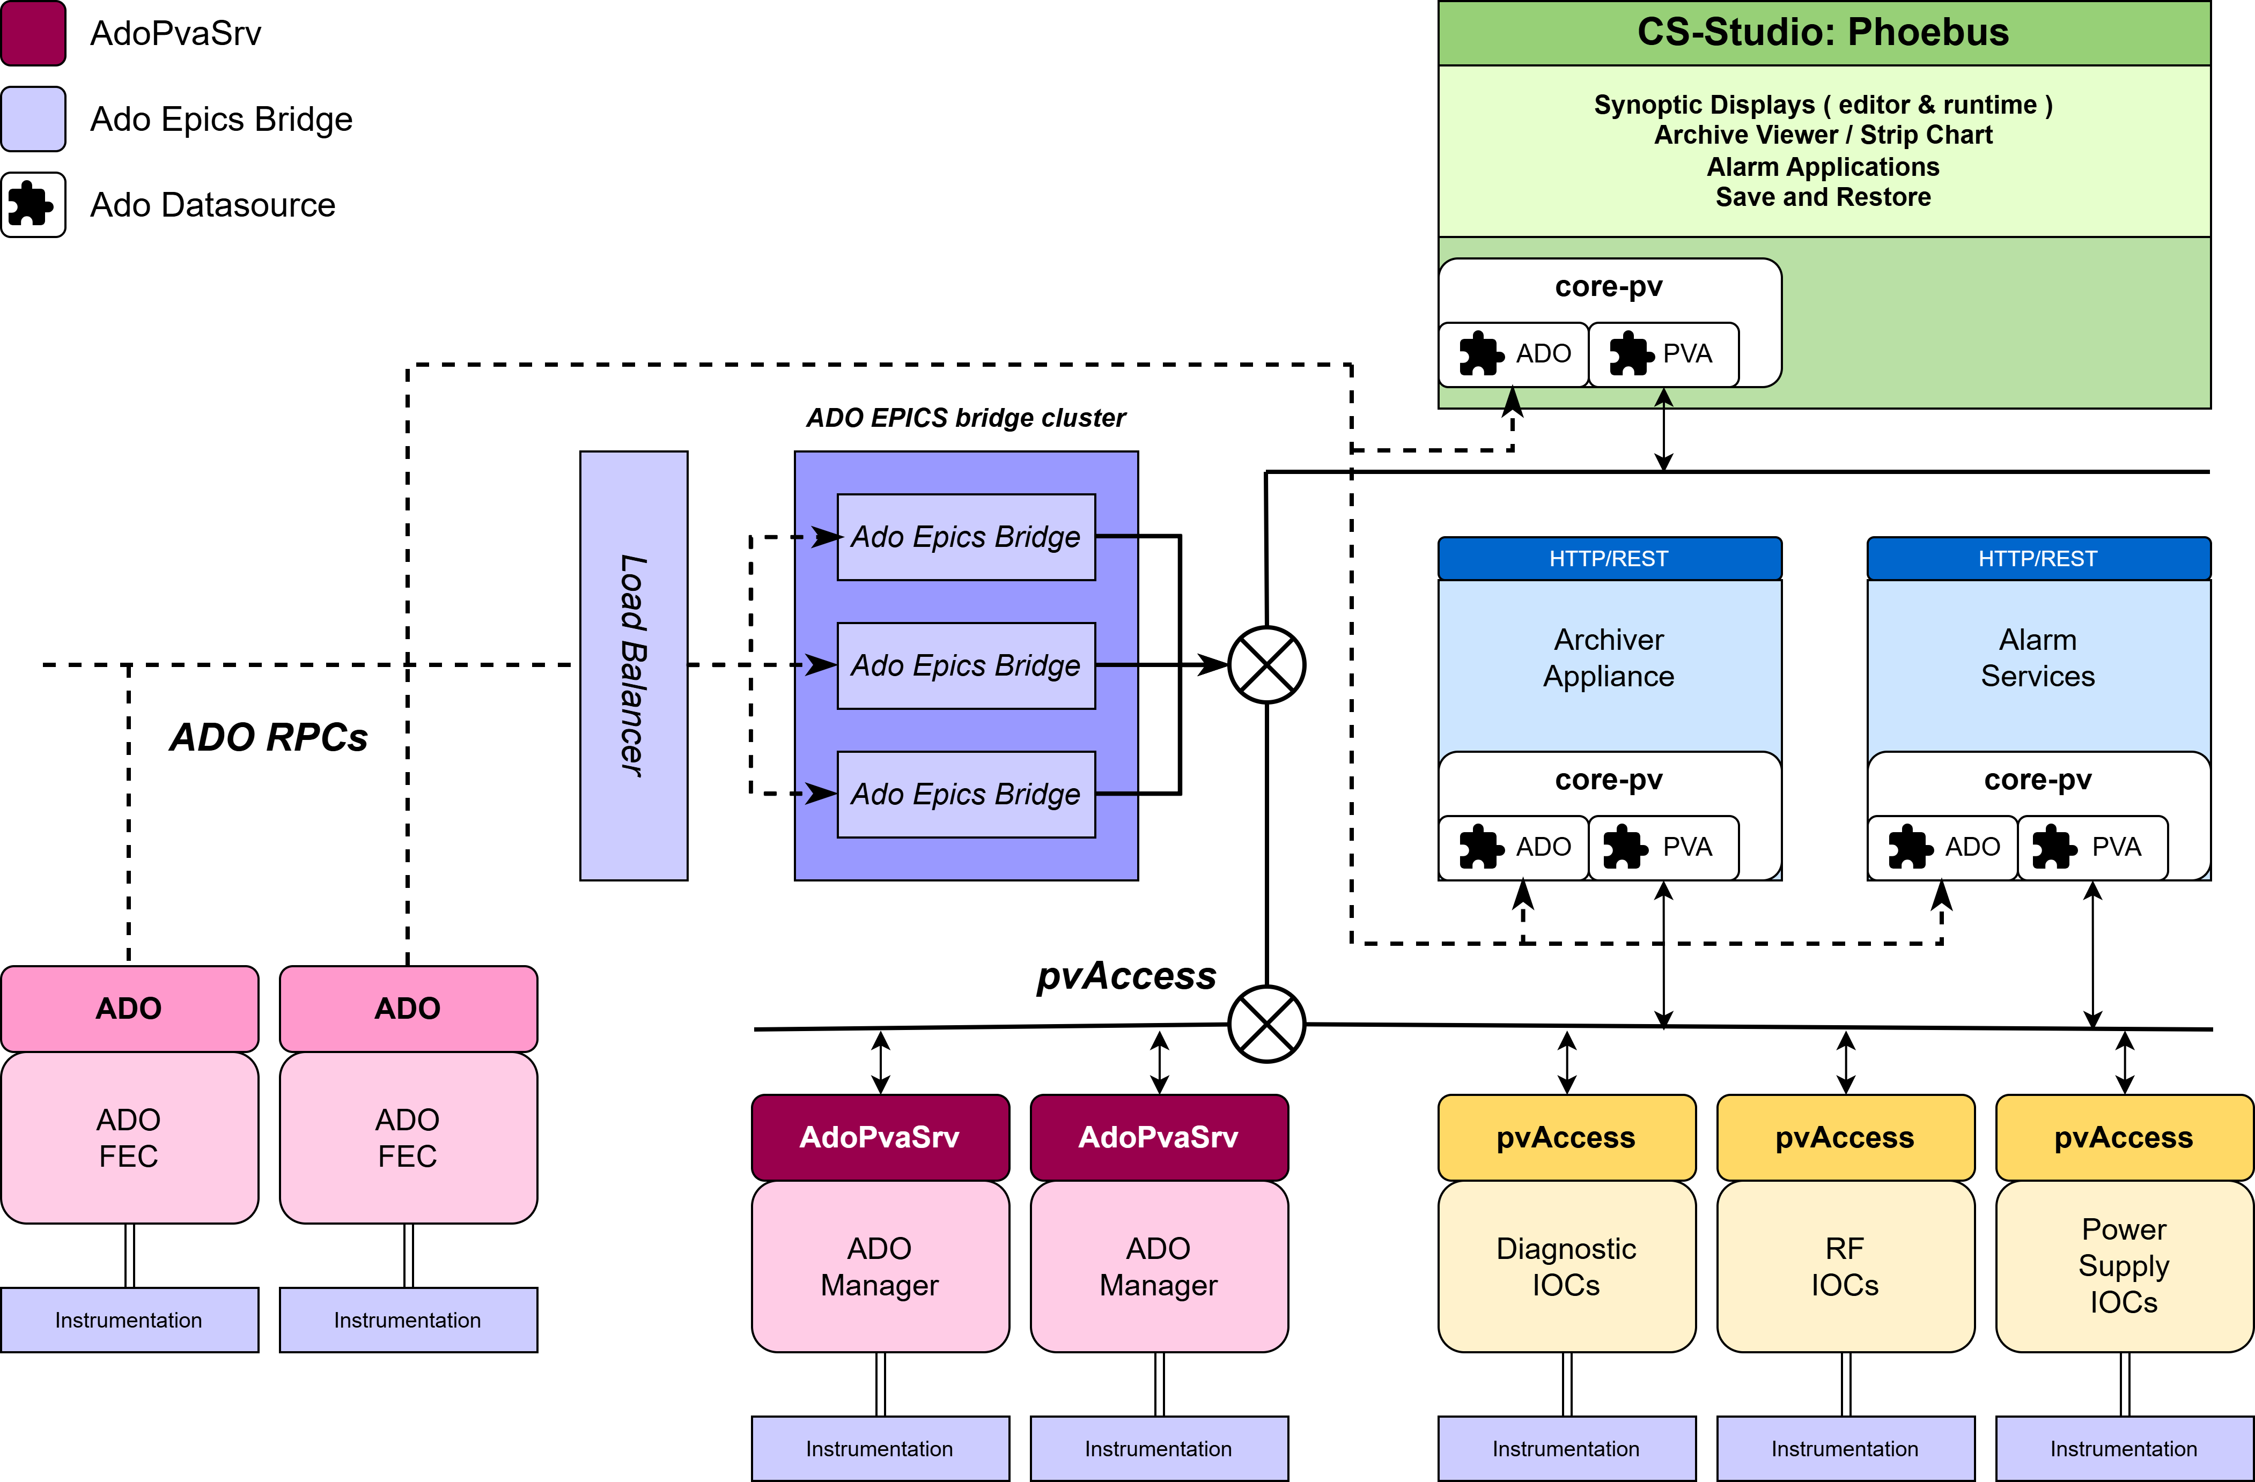
Dual System Architecture Diagram
Charge #3,4,5
[Talk-8/10-Kabir] EIC plan and dual-system need:
EIC performance goals (about two orders of magnitude luminosity increase vs RHIC) require modernized controls platforms
Software strategy prioritizes long-term maintainability for a 30+ year lifecycle and broader talent/community support
Therefore, the near-term architecture is intentionally dual-system: legacy ADO paths continue where needed while new systems are delivered on EPICS/PVA and migrated in phases
Notes:
EIC performance goals (about two orders of magnitude luminosity increase vs RHIC) require modernized controls platforms and scalable FPGA-based lower-level systems
Software strategy prioritizes long-term maintainability for a 30+ year lifecycle and broader talent/community support
Therefore, the near-term architecture is intentionally dual-system: legacy ADO paths continue where needed while new systems are delivered on EPICS/PVA and migrated in phases

Slide 15
Dual System Architecture Diagram
Charge #3,4,5
Strategy 1: AdoPvaSrv
AdoPvaSrv runs on each ADO Manager allowing it to speak pvAccess
Fully distributed with no central broker or gateway infrastructure required
Horizontally scalable
Can be rolled out iteratively
Notes:
AdoEpicsBridge is a p4p-based middle-layer bridge that connects to ADO on one side and publishes ADO-managed devices as EPICS PVs over pvAccess on the other, enabling EPICS clients and tools to access legacy ADO systems without any changes to the existing ADO infrastructure.

Slide 16
Dual System Architecture Diagram
Charge #3,4,5
Strategy 2: AdoEpicsBridge
A p4p-based bridge that exposes ADO devices as EPICS PVs over pvAccess
Requires no changes to existing ADO infrastructure — ADO devices and managers remain untouched
Seamlessly merges the two control systems from the EPICS side by exposing ADO devices as EPICS PVs
Primarily used for FEC; p4p-based bridge between ADO and EPICS (pvAccess)
Requires a cluster of AdoEpicsBridge instances with a load balancer — additional infrastructure investment, but achievable and well-understood
Notes:
AdoEpicsBridge is a p4p-based middle-layer bridge that connects to ADO on one side and publishes ADO-managed devices as EPICS PVs over pvAccess on the other, enabling EPICS clients and tools to access legacy ADO systems without any changes to the existing ADO infrastructure.

Slide 17
Dual System Architecture Diagram
Charge #3,4,5
Strategy 3: Ado Datasource
ADO protocol client in core-pv
Requires no changes to existing ADO infrastructure — ADO devices and managers remain untouched
Seamlessly merges the two control systems at the tools and services layer
No central broker or gateway infrastructure required
Notes:
AdoEpicsBridge is a p4p-based middle-layer bridge that connects to ADO on one side and publishes ADO-managed devices as EPICS PVs over pvAccess on the other, enabling EPICS clients and tools to access legacy ADO systems without any changes to the existing ADO infrastructure.

Slide 18
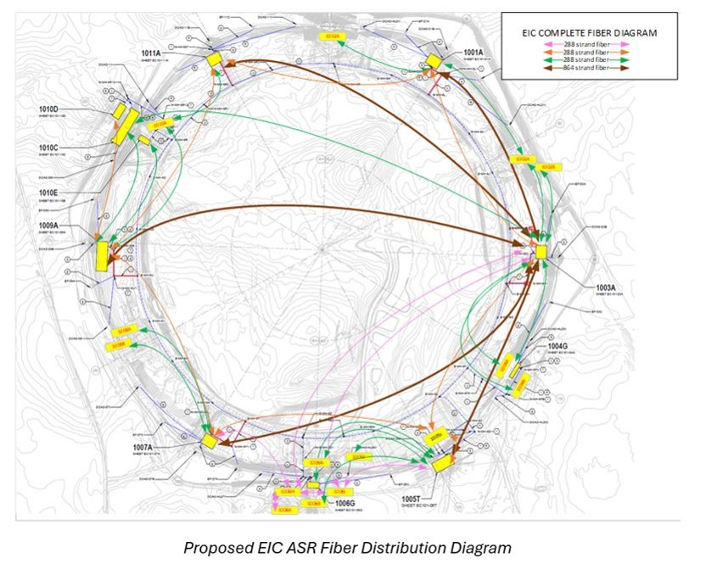
Network Architecture and Subnet Strategy
Charge #1,2
[Talk-6/7-Kulmatycski]
Network architecture goals:
Scalable connectivity for distributed and clustered components
Clear segmentation across controls, instrumentation, and data services
Subnet model:
Conrols subnet: IOC, ADO Manager, gateway, and command/control traffic
Instrumentation subnet: device-facing acquisition and timing-sensitive interfaces

Slide 19
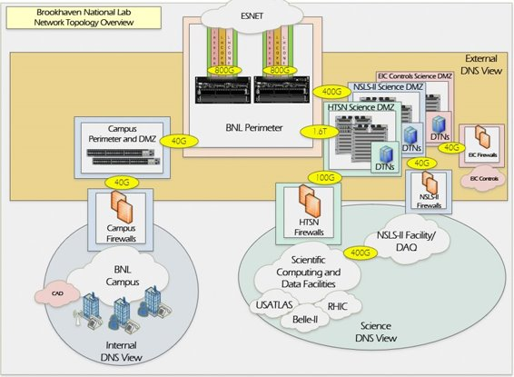
Network Architecture and Subnet Strategy
Charge #1,2
[Talk-6/7-Kulmatycski]
Integration and security :
Controlled cross-subnet access through gateways and service endpoints
Monitoring and observability at subnet and service boundaries
Coexistence deployment implications:
ADO server and bridge clusters placed for low-latency access to legacy domains
EPICS/PVA services scaled horizontally on service networks
Operator tools consume unified interfaces without direct dependency on backend protocol location

Slide 20
Middle-Layer Services
Charge #1,2,3
Operator and application layer (Phoebus tools, web tools, HLAs)
Middle-layer services (Archiver, Alarm, Olog, ChannelFinder, Save/Restore, Gateway)
Control system layer (EPICS 7 with PVA-first, CA compatibility)

Slide 21
Middle-Layer Services
Charge #1,2,3
Modular services: each service has a focused, well-defined role and can evolve independently
Flexible interfaces: support command-response and publish-subscribe patterns via standard service APIs
Data abstraction: tools interact with services, not storage internals, preserving user workflow while backends evolve
Optimized data handling: purpose-built stores per domain (time-series, alarms, snapshots, metadata)
Interoperable by design: consistent service contracts across tools and client environments
Scalable and maintainable: deploy and scale services independently based on facility demand

Slide 22
Middle-Layer Services
Charge #1,2,3
Archiver: EPICS Archiver Appliance stores time-series PV data at configurable rates and provides fast historical queries. Supports post-event analysis and correlation with live values in Data Browser
Alarm: Monitors, filters, and aggregates alarms in real-time, notifies operators, maintains alarm history, and supports configuration rollback. Enables both immediate response and retrospective tuning of alarm quality
ChannelFinder: Directory service for PV catalogs, tags, and properties
NameOps: Generate and validate EIC device and PV names
Olog (Online Logbook): Structured operator and operations logging with automatic context capture (PV names, alarm states, timestamps)
Save and Restore: Captures, stores, and restores PV snapshots that reproduce known good states. Supports repeatable operations and controlled recovery from incident or configuration changes
PVA Gateway: Enables EPICS-domain inter-network connectivity with controlled PV exposure across network boundaries. Supports scalable client access patterns without overwhelming IOC resources

Slide 23
Phoebus Operator Toolkit
Charge #1,2,3
Operator and application layer (Phoebus tools, web tools, HLAs)
Middle-layer services (Archiver, Alarm, Olog, ChannelFinder, Save/Restore, Gateway)
Control system layer (EPICS 7 with PVA-first, CA compatibility)

Slide 24
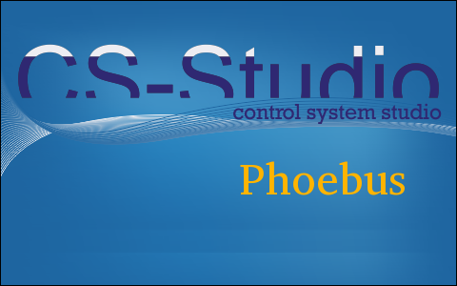
Phoebus Operator Toolkit
Charge #1,2,3,5
Integrated set of tools across displays, alarms, trends, logbook, and save/restore
Operators navigate seamlessly between tools
Context sharing reduces operator burden and improves efficiency
Single integrated desktop environment reduces training overhead and support burden
Extensible and Modular architecture
SPI-based extensibility allow sites to add tools and protocols without disrupting core stability
Shared data models, resources, etc allows for simplified and efficient applications
Large, active collaboration strengthens maintainability and support

Slide 25
Phoebus Operator Toolkit
Charge #1,3,7
Display Builder: OPI/HMI editor and runtime with alarm awareness, units, and precision. Supports legacy display migration (EDM, MEDM, BOY auto-conversion) and web-based runtime execution.
Data Browser: Trending across multiple archive providers (Archiver Appliance, RDB, TimescaleDB). Enables correlation analysis with live PV values in unified plotting environment.
Alarm UI: Real-time alarm monitoring with high-level overviews, alarm tables, hierarchical trees, and voice annunciator. Ensures critical conditions are surfaced and managed efficiently.
Olog (Logbook UI): Structured operator logging with automatic PV/alarm/timestamp context capture. Integrated within Phoebus for seamless workflow documentation.
PV Utilities: Probe for detailed introspection, PV Table for monitoring and save/restore groups, PV Tree for record linkages. Support diagnostics and day-to-day operations.
ChannelFinder Client: Fast, case-insensitive PV discovery with metadata search (IOC host, record type, status). Hierarchical views improve navigability of flat EPICS namespace.
Save/Restore UI: Snapshot capture, versioning, and restoration with merge/scale capabilities. Enables reproducible operations and rapid recovery from configuration changes.

Slide 26
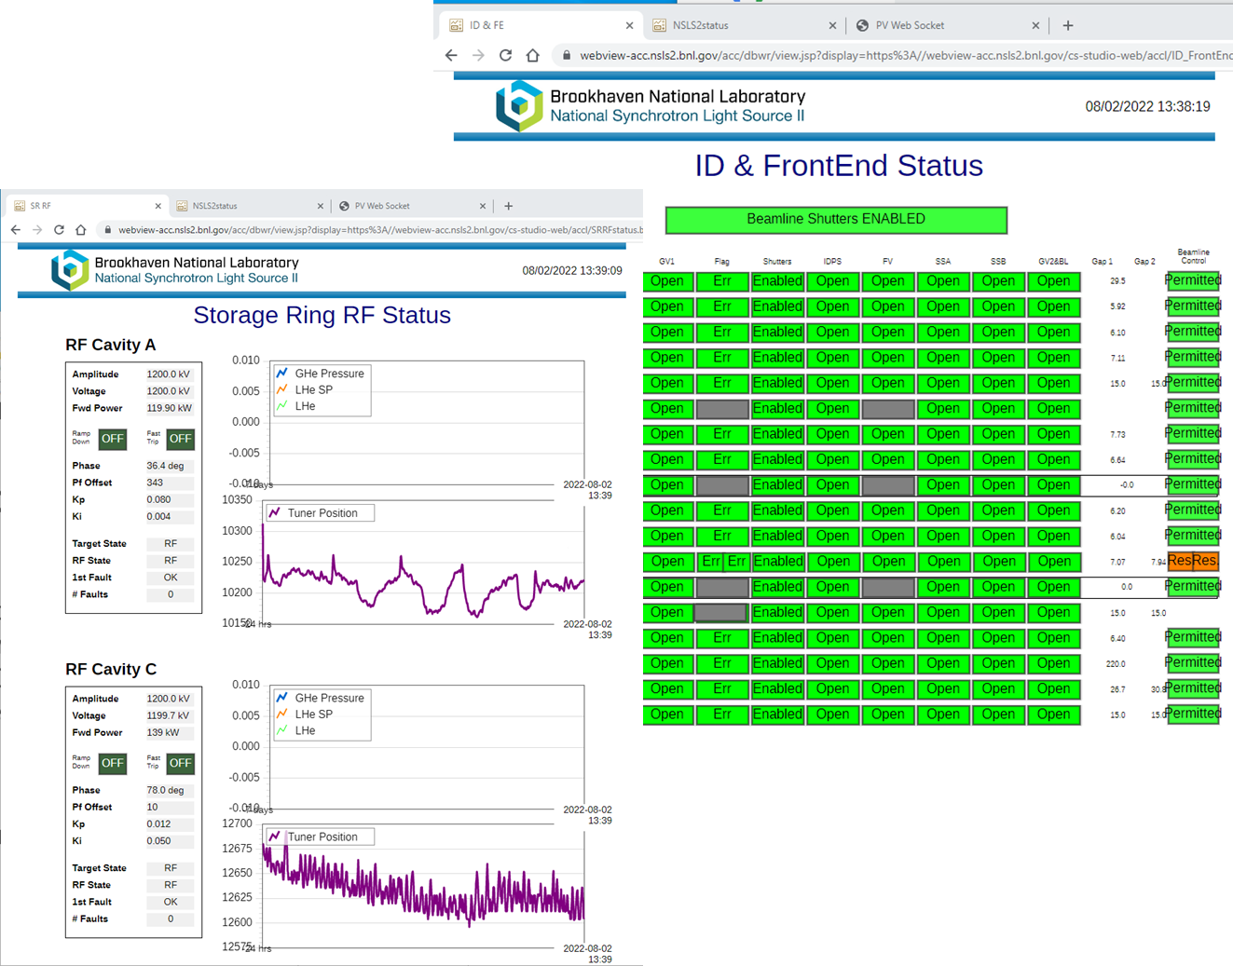
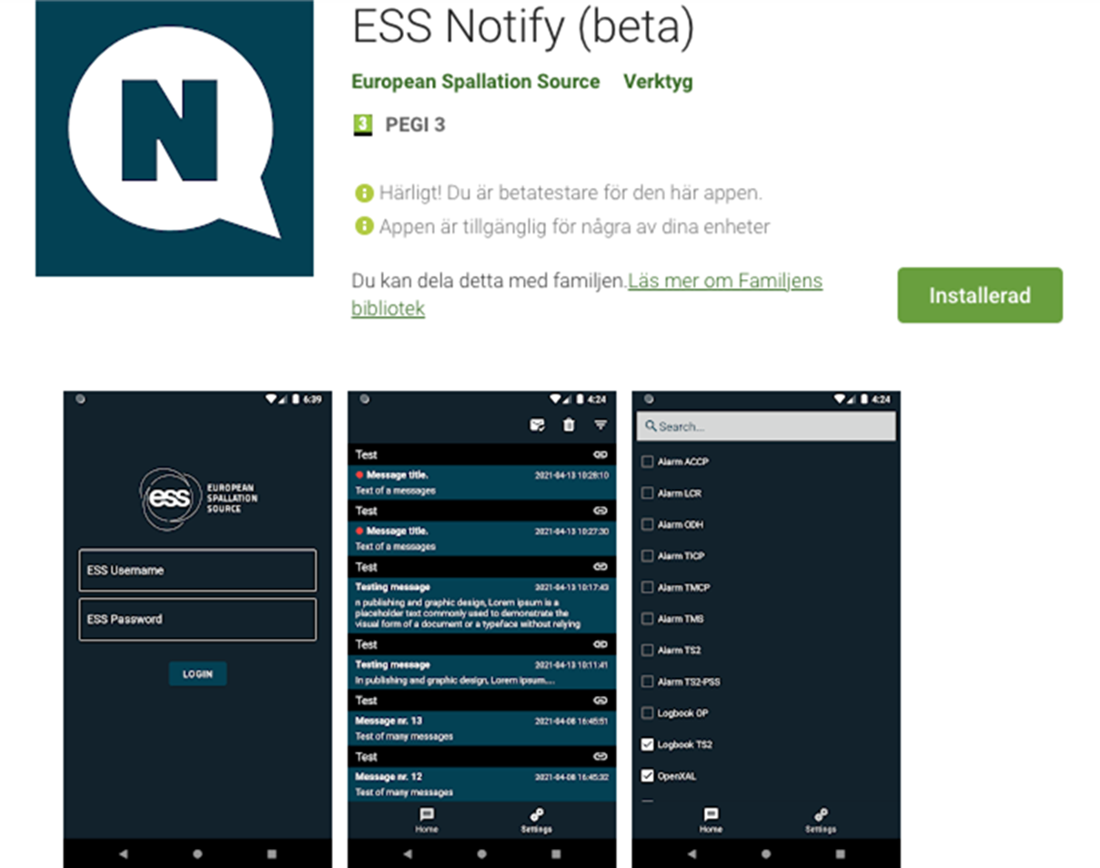
Web Tools
Charge #1,3,7
Why web applications are needed:
Phoebus desktop remains the rich operator environment for integrated control-room workflows
Web tools complement desktop with easier access, flexible deployment, and lightweight views for broader users
EIC web tools:
`pvws` and `dbwr`: WebSocket-based toolkit for displaying controls information on web pages and archive-oriented views
Web clients for Olog, `etraveller`, and component database workflows
`pvinfo`: web/CLI PV metadata and connection-status lookup
Notes:
- **Operating model:** - **Desktop and web clients use the same underlying controls/services data, so access modes stay consistent.** - **Web tools extend access and visibility; they complement, not replace, the Phoebus desktop workflow.**

Slide 27
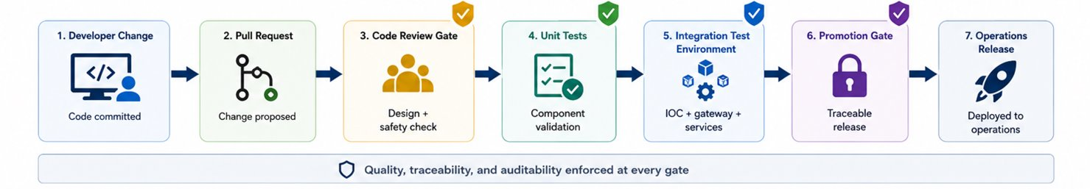
QA/QC
Charge #1,6,7
How QA/QC is embedded into code review, unit tests, and integration tests before changes reach operations.
QA/QC control points:
Code review gates: pull request templates, review checklists, and mandatory approvals enforce design and safety expectations before any change is merged.
Unit tests: per-component build validation, syntax checks, and schema conformance gates run automatically on each change before merge — catching individual component regressions early.
Integration tests: post-merge deployment into a controlled test environment validates that components interact correctly — IOC + gateway + service stack behavior tested together before promotion.
Promotion gates: release to operations only after both unit and integration test suites pass, with artifact traceability linking each deployed version to its validated test record.
Dev/test environment enablement:
Rapid environment setup from versioned automation definitions
Reproducible test conditions across team members and subsystems
Faster defect isolation and higher confidence before production rollout
Notes:
- **CI/CD purpose for controls architecture:** - **Standardize delivery workflows across infrastructure, controls software, and operations tooling** - **Reduce integration risk through automated validation and repeatable deployment steps** - **Improve traceability from design change to deployed system state** - **Industry-aligned workflow model:** - **Git-based change control with pull request approvals and protected branches** - **Pipeline-first validation before integration and release** - **Infrastructure as code as the default operating model for environment setup and updates** - **GitHub as source control platform:** - **Full history and traceability of architecture, code, configuration, and operations assets** - **Structured collaboration via pull requests, reviews, and issue tracking** - **Branch protection and CODEOWNERS enforce controlled change paths** - **GitHub Actions for CI/CD orchestration:** - **Automated build, test, packaging, and deployment workflows** - **Reusable workflows reduce duplication and enforce common standards** - **Environment-aware pipelines for development, test, and production readiness** - **Ansible and AWX for operational automation:** - **Ansible playbooks define desired state for systems and services** - **AWX provides managed execution, scheduling, credential handling, and run visibility** - **Consistent, repeatable rollouts across multiple environments** - **Infrastructure as code principles:** - **Version-controlled infrastructure definitions and configuration policies** - **Reviewable, auditable changes to platform and service topology** - **Drift reduction through repeatable automation runs** 2. Emphasize that CI/CD is part of architecture maturity, not only software process. 3. Focus on the end-to-end toolchain, not isolated tools.

Slide 28
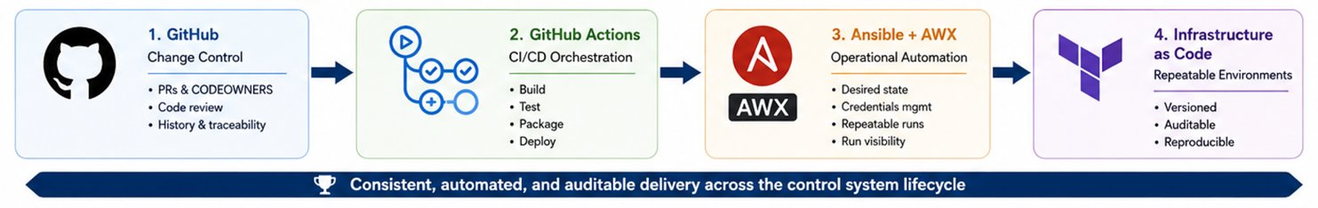
CI/CD and Automation Stack
Charge #1,6,7
CI/CD purpose for controls architecture:
Standardize delivery workflows across infrastructure, controls software, and operations tooling; reduce integration risk through automated validation and repeatable deployment steps; improve traceability from design change to deployed system state.
Change control (GitHub):
Structured collaboration through pull requests, reviews, and issue tracking; branch protection and CODEOWNERS enforce controlled change paths; full history and traceability across architecture, code, configuration, and operations assets.
Orchestration (GitHub Actions):
Automated build, test, packaging, and deployment workflows; reusable workflows reduce duplication and enforce common standards; environment-aware pipelines support development, test, and production readiness.
Operational automation (Ansible/AWX + IaC):
Ansible playbooks define desired state, AWX provides managed execution and visibility, and infrastructure-as-code keeps environment setup and updates version-controlled, reviewable, auditable, and repeatable.
Notes:
- **CI/CD purpose for controls architecture:** - **Standardize delivery workflows across infrastructure, controls software, and operations tooling** - **Reduce integration risk through automated validation and repeatable deployment steps** - **Improve traceability from design change to deployed system state** - **Industry-aligned workflow model:** - **Git-based change control with pull request approvals and protected branches** - **Pipeline-first validation before integration and release** - **Infrastructure as code as the default operating model for environment setup and updates** - **GitHub as source control platform:** - **Full history and traceability of architecture, code, configuration, and operations assets** - **Structured collaboration via pull requests, reviews, and issue tracking** - **Branch protection and CODEOWNERS enforce controlled change paths** - **GitHub Actions for CI/CD orchestration:** - **Automated build, test, packaging, and deployment workflows** - **Reusable workflows reduce duplication and enforce common standards** - **Environment-aware pipelines for development, test, and production readiness** - **Ansible and AWX for operational automation:** - **Ansible playbooks define desired state for systems and services** - **AWX provides managed execution, scheduling, credential handling, and run visibility** - **Consistent, repeatable rollouts across multiple environments** - **Infrastructure as code principles:** - **Version-controlled infrastructure definitions and configuration policies** - **Reviewable, auditable changes to platform and service topology** - **Drift reduction through repeatable automation runs** 2. Emphasize that CI/CD is part of architecture maturity, not only software process. 3. Focus on the end-to-end toolchain, not isolated tools.

Slide 29
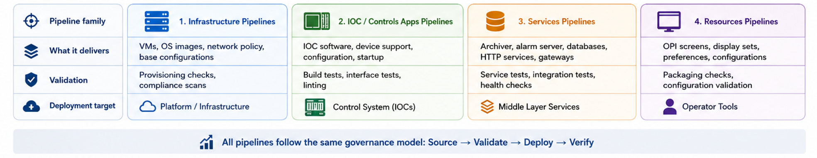
CI/CD Pipelines
Charge #1,6,7
CI/CD and automated deploy pipelines eliminate manual, error-prone delivery steps — replacing them with repeatable, auditable workflows that enforce quality gates from code change to production system.
Infrastructure pipelines:
VM provisioning and base image configuration
Network and policy artifacts (including firewall and routing policy updates)
IOC and controls application pipelines:
Build, package, and deploy IOC software and associated configuration
Phoebus Tools and Service pipelines:
Deploy and update archiver, alarm, databases, and HTTP service components
Phoebus product packaging and distribution updates
Resource pipelines:
OPI screens, preferences, and configuration management artifacts
Notes:
Configuration changes through versioned automation
Verify service health and interface compatibility post-deployment

Slide 30
Summary
EPICS 7 with pvAccess-first architecture is the controls baseline for new EIC systems
Legacy ADO systems remain part of the near-term plan, with defined coexistence paths through AdoPvaSrv, AdoEpicsBridge, and Ado Datasource
Network architecture provides the structure for scalable and maintainable operations
Middle-layer services and Phoebus tooling provide the operator and integration framework for the controls stack
The controls stack is designed to support long-term operability, collaboration, and phased migration during EIC construction
QA/QC gates and CI/CD automation provide the delivery and governance framework needed for final design progression

